Slide 1
Chapter 2
Problems , Problem spaces , And Search

Slide 2
To build a system to solve a particular problem :
Define the problem precisely
Analyze the problem
Isolate and represent the task knowledge
Choose the best problem solving technique.

Slide 3
Problem solving is a process of generating solutions from observed data.
• a ‘problem’ is characterized by a set of goals,
• a set of objects, and
• a set of operations.
These could be ill-defined and may evolve during problem solving.
• A ‘problem space’ is an abstract space.
A problem space encompasses all valid states that can be generated by the application of any combination of operators on any combination of objects.
The problem space may contain one or more solutions. A solution is a combination of operations and objects that achieve the goals.
• A ‘search’ refers to the search for a solution in a problem space.
Search proceeds with different types of ‘search control strategies’.
The depth-first search and breadth-first search are the two common search strategies.

Slide 4
State Space Search
A state space represents a problem in terms of states and operators that change states.
A state space consists of:
A representation of the states the system can be in. For example, in a board game, the board represents the current state of the game.
A set of operators that can change one state into another state. In a board game, the operators are the legal moves from any given state. Often the operators are represented as programs that change a state representation to represent the new state.
An initial state.
A set of final states; some of these may be desirable, others undesirable. This set is often represented implicitly by a program that detects terminal states.

Slide 5
Defining the problem as state space search
A Water Jug Problem: You are given two jugs, a 4-gallon one and a 3-gallon one, a pump which has unlimited water which you can use to ll the jug, and the ground on which water may be poured. Neither jug has any measuring markings on it.
How can you get exactly 2 gallons of water in the 4-gallon jug?

Slide 6
State Representation and Initial State
we will represent a state of the problem as a tuple (x, y) where x represents the amount of water in the 4-gallon jug and y represents the amount of water in the 3-gallon jug.
So here X = 0,1,2,3,4 and Y=0,1,2,3
Our initial state: (0,0)
Goal state = (2,y) where 0 <= y <= 3.

Slide 7
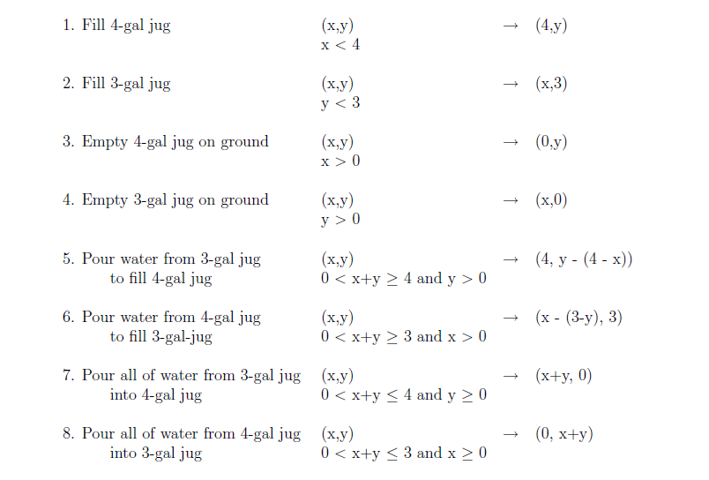
Operators : we must define a set of operators that will take us from one state to another:

Slide 8
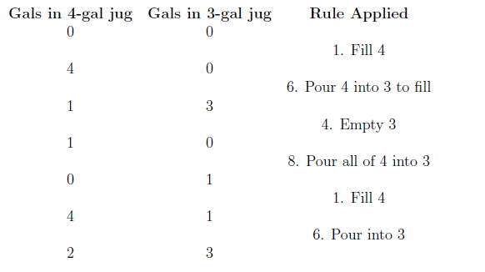
Solution:

Slide 9
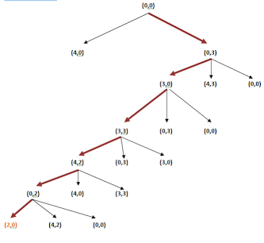

Slide 10
Operationalization
Process in which programs themselves produce formal descriptions from the informal ones.

Slide 11
InClassExercise#1
Given:
a five gallon jug
a seven gallon jug
a way to fill up the jugs
a way to pour out water
End up with:
exactly 1 gallon of water in one of the jugs.

Slide 12
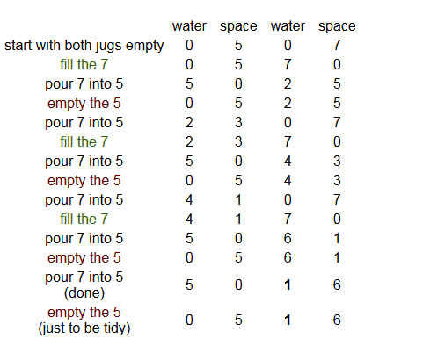
solution

Slide 13
8-puzzle problem
Eight puzzle (8-Puzzle)
The 8-puzzle is a 3 × 3 array containing eight square pieces, numbered 1 through 8, and one empty space. A piece can be moved horizontally or vertically into the empty space, in effect exchanging the positions of the piece and the empty space. There are four possible moves, UP (move the blank space up), DOWN, LEFT and RIGHT. The aim of the game is to make a sequence of moves that will convert the board from the start state into the goal state:

Slide 14
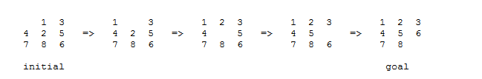

Slide 15
Operators: Left, Right, Up, Down

Slide 16
Example: Missionaries and Cannibals
The Missionaries and Cannibals problem illustrates the use of state space search for planning under constraints:
Three missionaries and three cannibals wish to cross a river using a two person boat. If at any time the cannibals out number the missionaries on either side of the river, they will eat the missionaries. How can a sequence of boat trips be performed that will get everyone to the other side of the river without any missionaries being eaten?

Slide 17
State space
(L,R) – set of ordered pair of left and right bank of the river
Each bank is represented by [nM,mC,B] where n= number of missionaries, m=number of cannnibals and B represents boat
Start State : [(3M,3C,1B),(0M,0C,0B)]
Goal state : [(0M,0C,0B),(3M,3C,1B)]

Slide 18
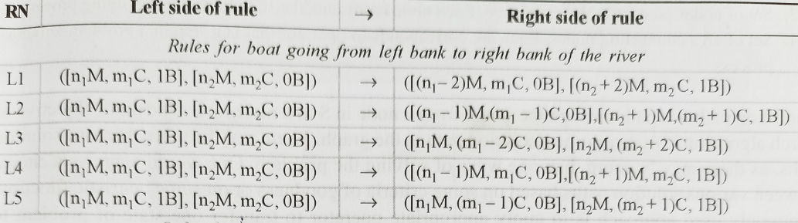
Operators

Slide 19
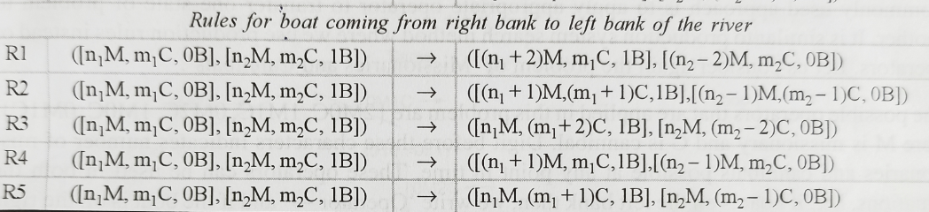

Slide 20
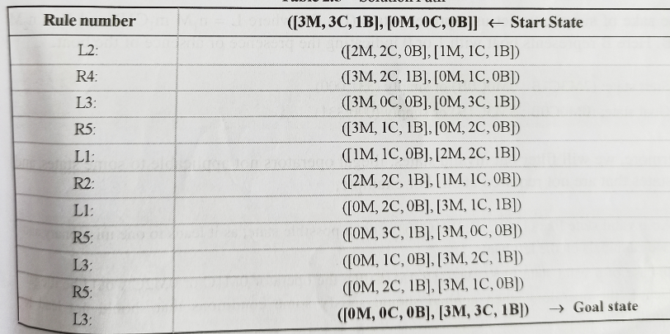
Solution Path

Slide 21
State representation:
1. BOAT position: original (T) or final (NIL) side of the river.
2. Number of Missionaries and Cannibals on the original side of the river.
3. Start is (T 3 3); Goal is (NIL 0 0).

Slide 22
Operators

Slide 23
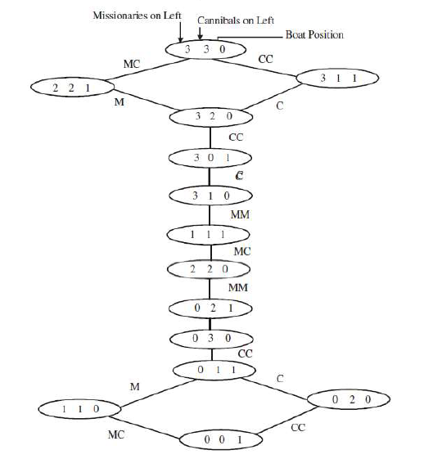

Slide 24
State Space Search: Summary
Define a state space that contains all the possible configurations of the relevant objects.
2. Specify the initial states.
3. Specify the goal states.
4. Specify a set of rules:
− What are unstated assumptions?
− How general should the rules be?
− How much knowledge for solutions should be in the
rules?

Slide 25
PRODUCTION SYSTEMS
Production systems provide appropriate structures for performing and describing search processes.
A production system has four basic components as enumerated below.
A set of rules
A database of current facts established during the process of inference
A control strategy
A rule applier

Slide 26
Control strategies
Requirements
It causes motion
It should be systematic

Slide 27
Directions in which search could proceed
Data-driven search called forward chaining, from the start state
Goal-driven search called backward chaining from the goal state

Slide 28
General observations
Move from smaller set of states to the larger set of state and proceed in the direction with the lower branching factor.
Branching factor is the average number of nodes that can be reached directly from single node.
Example theorem in mathematics: from set of axioms, large number of theorem can be proved on the other hand, the large number of theorems must go back to the small set of axioms. Hence branching factor is significantly greater going forward from axioms to theorem rather than going from theorems to axioms
Therefore proving theorems using backward strategy is more useful

Slide 29
Search Strategies
1. Uninformed search (blind search)
Having no information about the number of steps from the current state to the goal.
Domain Specific Knowledge is not there to guide us
2. Informed search (heuristic search)
More efficient than uninformed search.
We have function to guide the search procedure

Slide 30
Outline of Basic Search algorithm
1. Initialize : set OPEN = { start state s}
2. Fail : If OPEN = { } ; Terminate with failure
3. Select : select a state n from OPEN ,
4. Check: If n belongs to G ; Terminate with success
5. Expand : Generate the successor of n using O and insert into OPEN
6. Loop : Step 2

Slide 31
Search Strategies (queue – BFS stack – DFS)
(0, 0)
(4, 0)
(0, 3)
(4, 3)
(0, 0)
(1, 3)
(4, 3)
(0, 0)
(3, 0)

Slide 32
Search Strategies: Blind Search
Breadth-first search
Expand all the nodes of
one level first.
requires more memory
If many Goals exists beneficial
will not get trapped into blind alley
Depth-first search
Expand one of the nodes at
the deepest level.
requires less memory
may find solution without examining
much of the search space at all

Slide 37
Search Strategies: Blind Search
Criterion | Breadth-First | Depth-First
Time | b^{d} | b^{m}
Space | b^{d} | bm
Optimal? | Yes | No
Complete? | Yes | No
b: branching factor d: solution depth m: maximum depth

Slide 38
Issues
Uninformed search : motion causing and systematic control structure would do for simple problems
TSP:shortest possible round trip that both start and finishes at any one of the cities.
Combinatorial explosion
Branch and bound

Slide 39
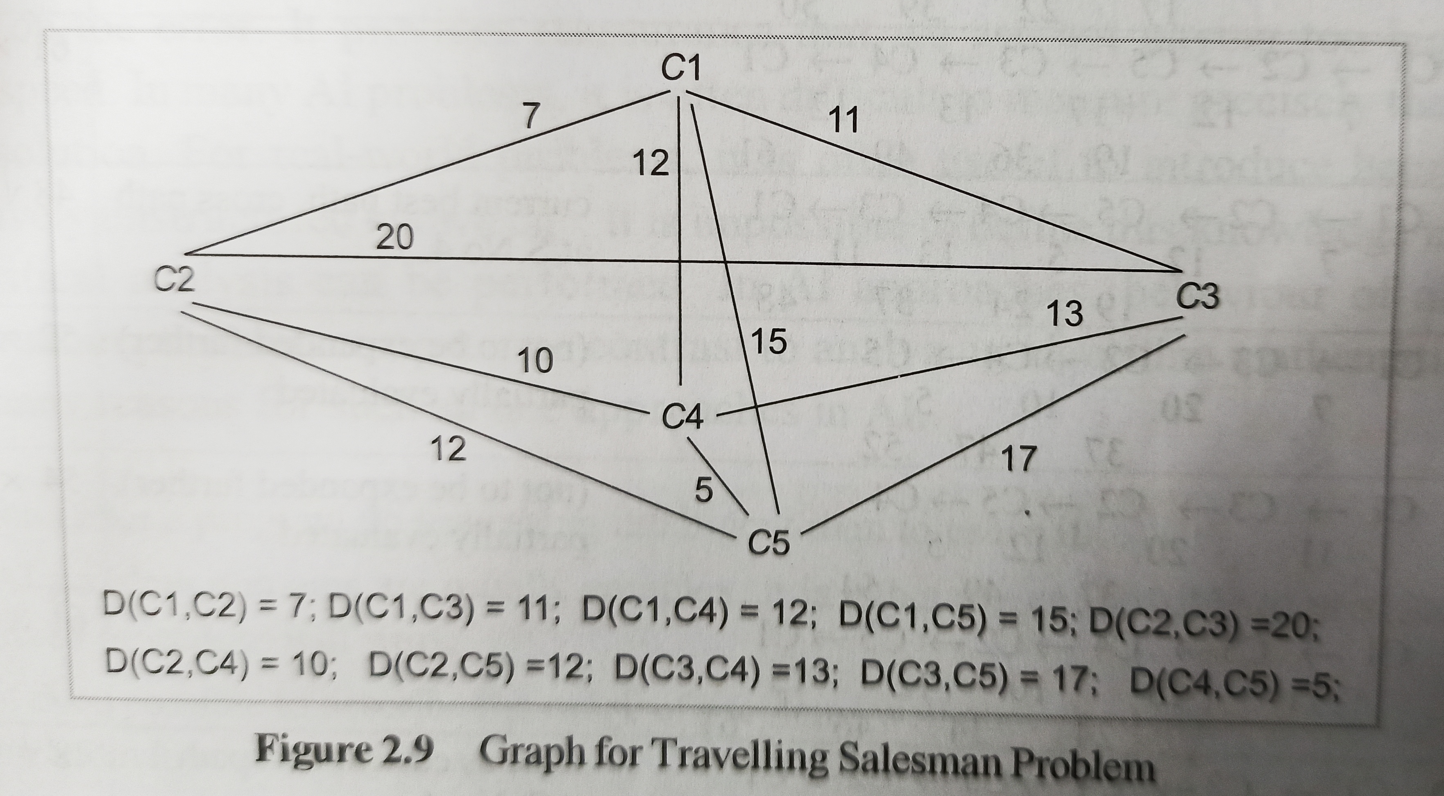

Slide 40
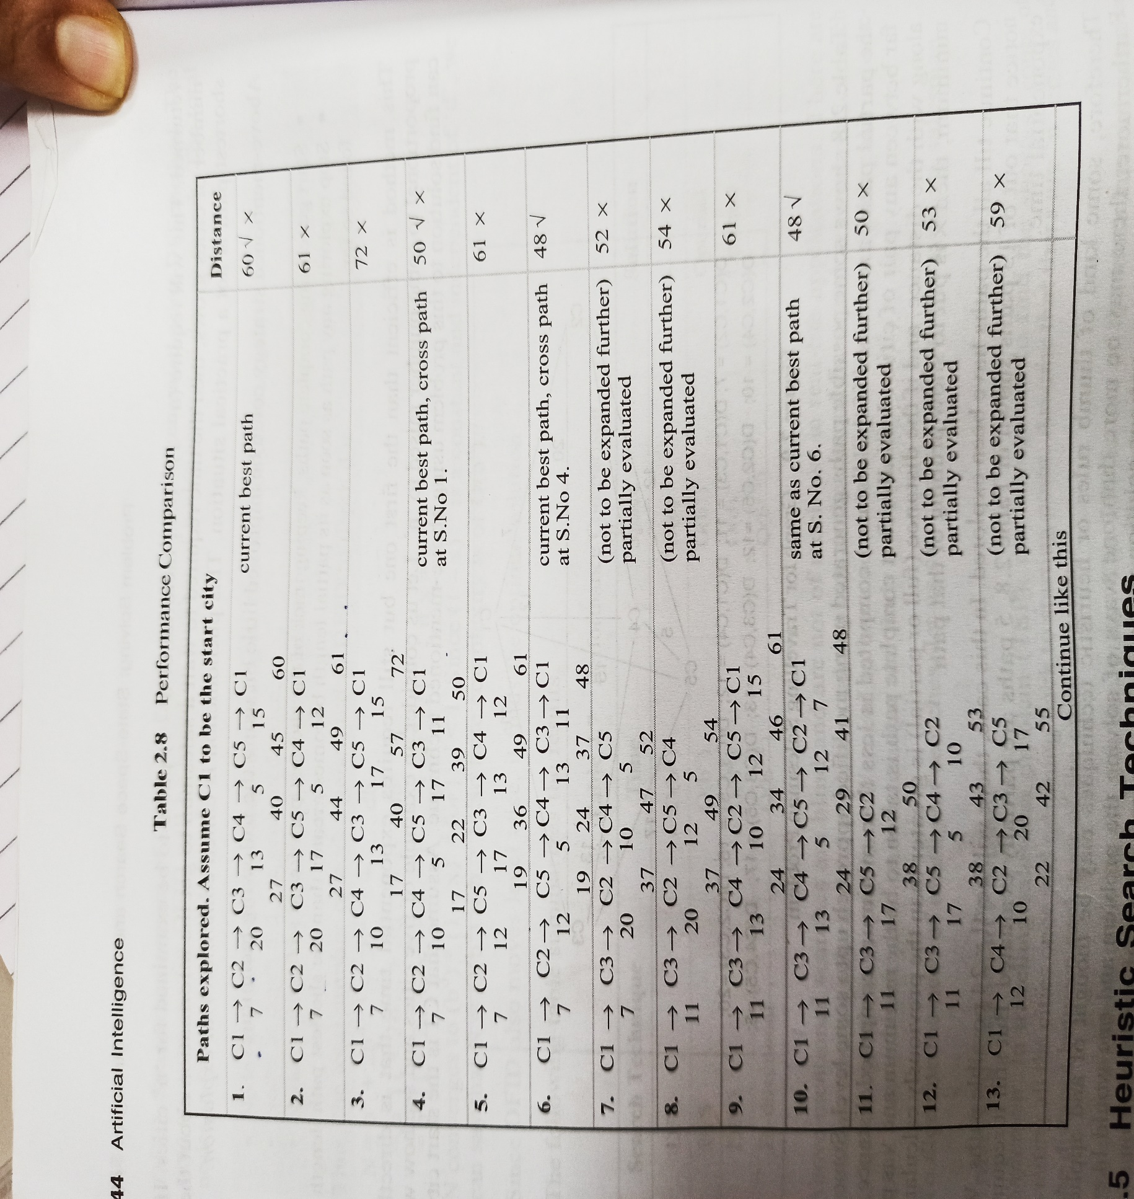

Slide 41
Heuristic search
Heuristic - a “rule of thumb” used to help guide search
often, something learned experientially and recalled when needed
Heuristic Function - function applied to a state in a search space to indicate a likelihood of success if that state is selected
heuristic search methods are known as “weak methods” because of their generality and because they do not apply a great deal of knowledge
the methods themselves are not domain or problem specific, only the heuristic function is problem specific
Heuristic Search –
given a search space, a current state and a goal state
generate all successor states and evaluate each with our heuristic function
select the move that yields the best heuristic value
Here and in the accompanying notes, we examine various heuristic search algorithms
heuristic functions can be generated for a number of problems like games, but what about a planning or diagnostic situation?

Slide 42
Uses the estimated cost from a node to the goal to determine its desirability.
The heuristic function estimates distance remaining to a goal.
h(n) = estimated cost of path from node to the goal.
In general, a heuristic is a technique that improves average-case performance
but may not improve worst-case performance.
Greedy algorithms often perform very well. They tend to find good solutions
quickly, although not always optimal ones.

Slide 43
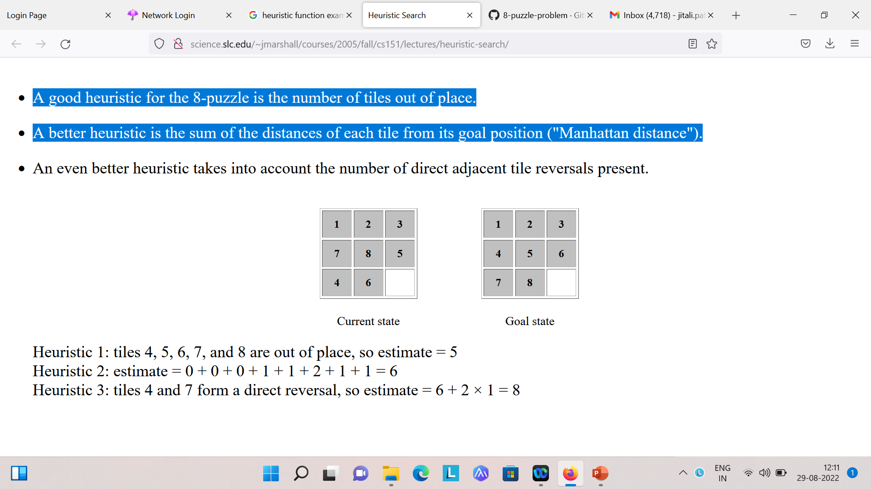
A good heuristic for the 8-puzzle is the number of tiles out of place.
A better heuristic is the sum of the distances of each tile from its goal
position ("Manhattan distance").

Slide 44
Production Systems
A monotonic production system
A non-monotonic production system
A partially commutative production system
A commutative production system

Slide 45
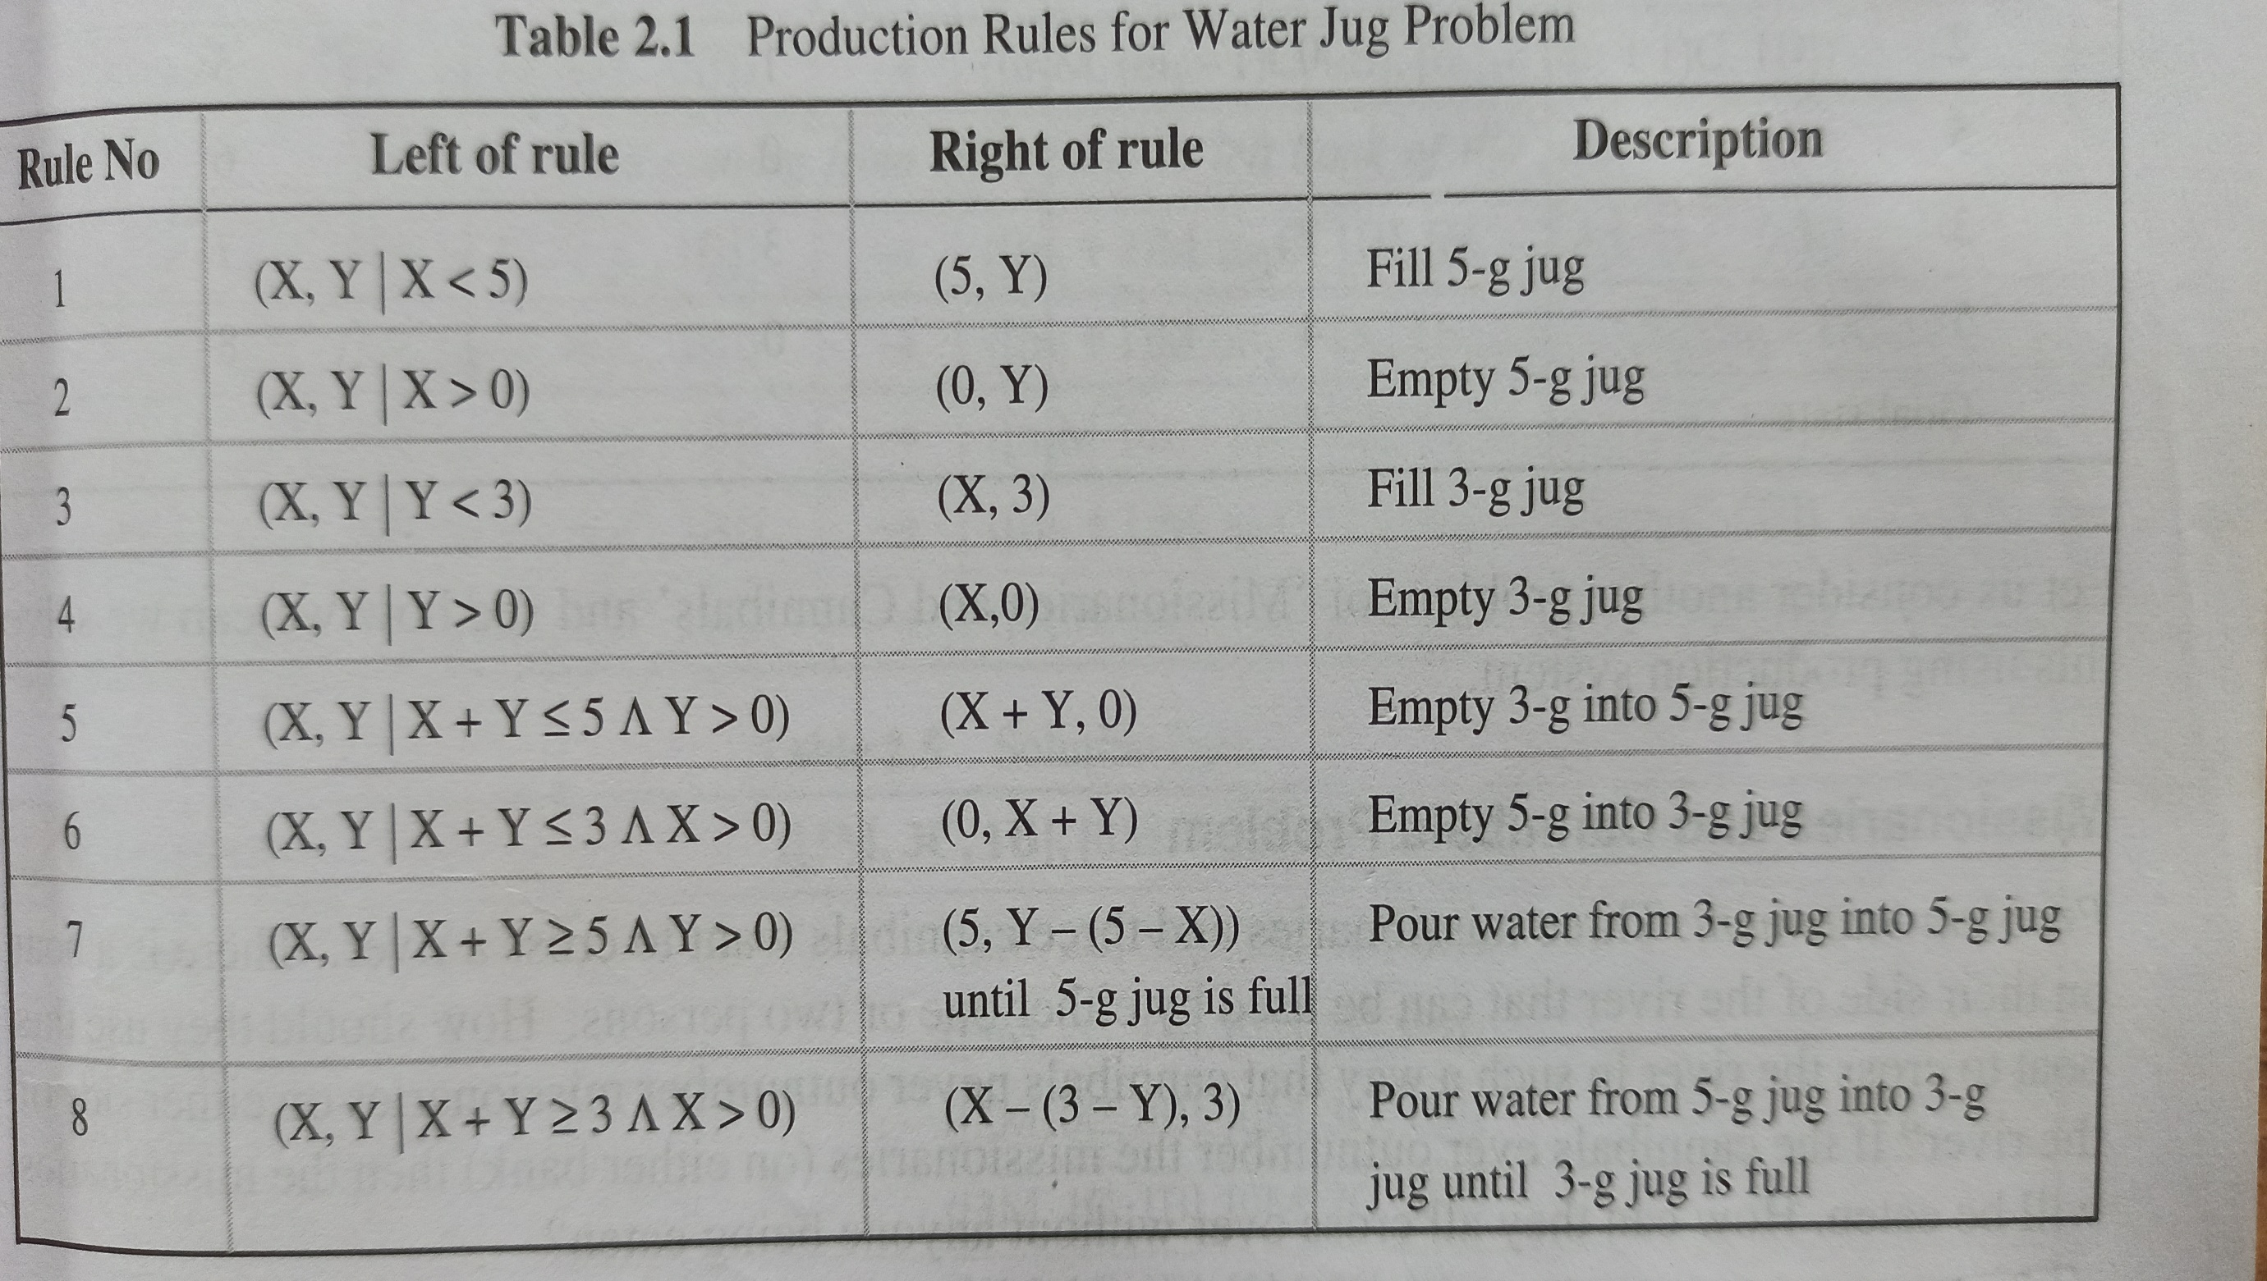

Slide 46
Monotonic Production System: It’s a production system in which the application of a rule never prevents the later application of another rule, that could have also been applied at the time the first rule was selected.

Slide 47
Non-Monotonic Production Systems are useful for solving ignorable problems. These systems are important for man implementation standpoint because they can be implemented without the ability to backtrack to previous states when it is discovered that an incorrect path was followed. This production system increases the efficiency since it is not necessary to keep track of the changes made in the search process.

Slide 48
Partially Commutative Production System: It’s a type of production system in which the application of a sequence of rules transforms state X into state Y, then any permutation of those rules that is allowable also transforms state x into state Y. Theorem proving falls under the monotonic partially communicative system.

Slide 49
Commutative Systems are usually useful for problems in which changes occur but can be reversed and in which the order of operation is not critical for example the, 8 puzzle problem. Production systems that are not usually not partially commutative are useful for many problems in which irreversible changes occur, such as chemical analysis. When dealing with such systems, the order in which operations are performed is very important and hence correct decisions must be made at the first time itself.

Slide 50
